Slide 1
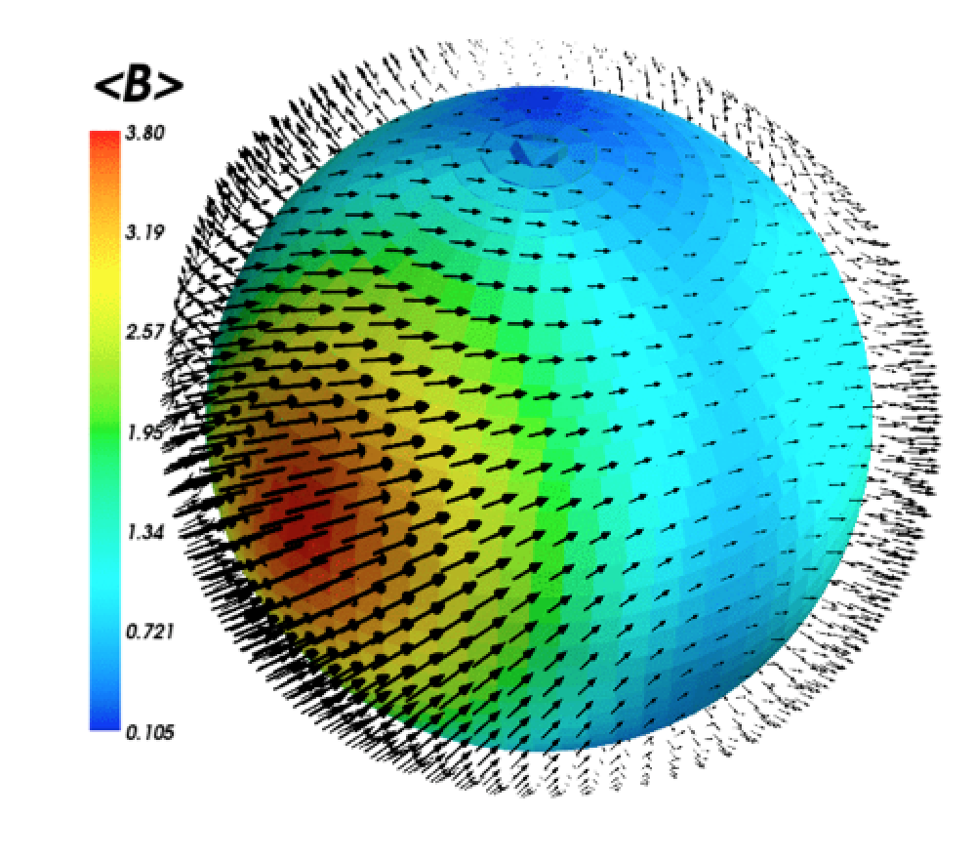
BCool
Introduction and Highlights
Pascal Petit
S. Jeffers, S. Marsden,
J. Morin, A. Vidotto,
BCool collaboration

Slide 2
Outline
LSD extraction of Zeeman signatures
Bcool snapshot survey
ZDI surface mapping
Global trends from Bcool ZDI sample

Slide 3
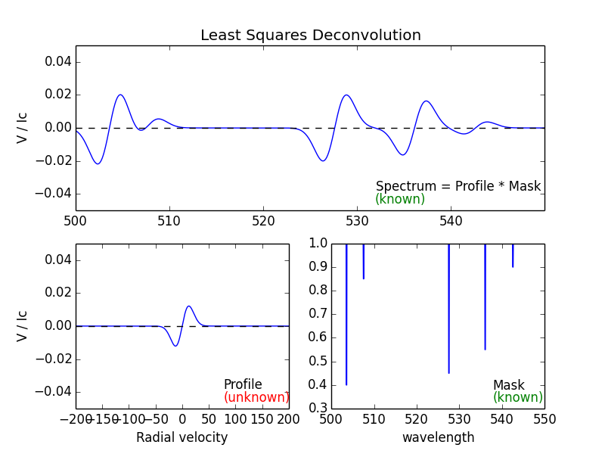
Least-Squares Deconvolution (LSD)
Multi-line extraction of « mean » Stokes V pseudo-line profile:
Donati+ 1997, Kochukhov+ 2010

Slide 4
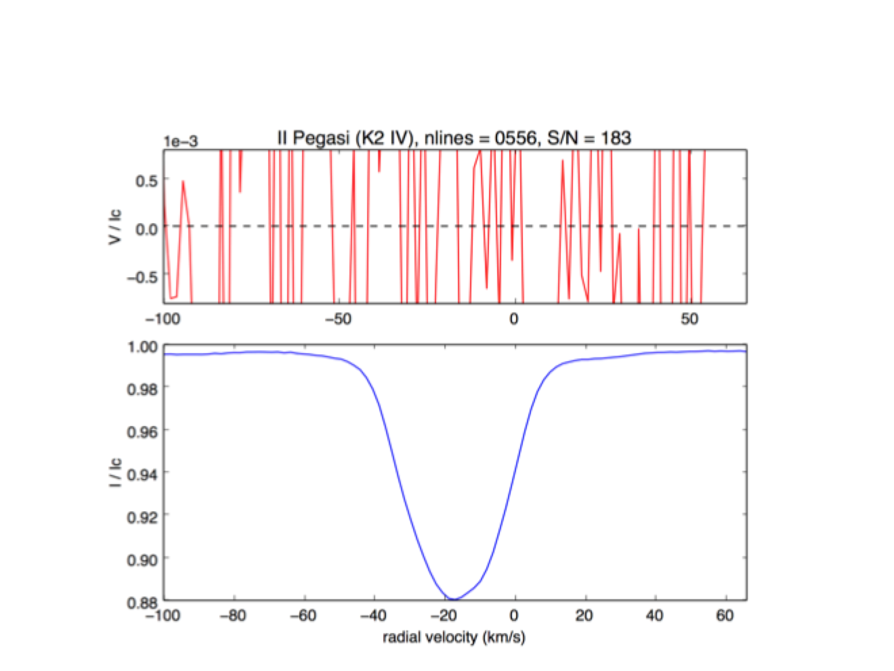
Least-Squares Deconvolution (LSD)

Slide 5
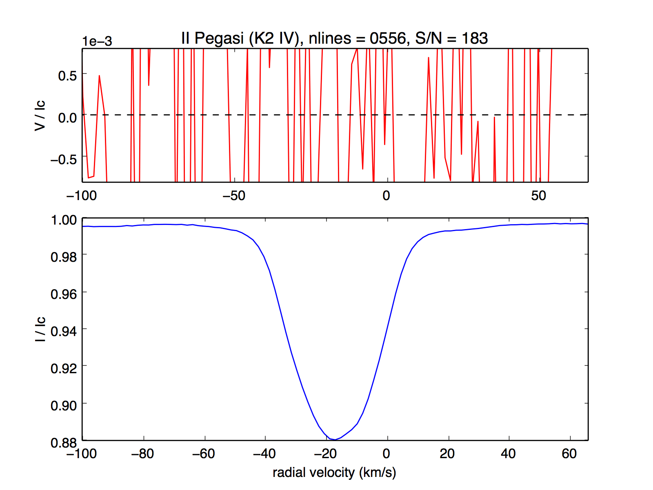
Least-Squares Deconvolution (LSD)

Slide 6
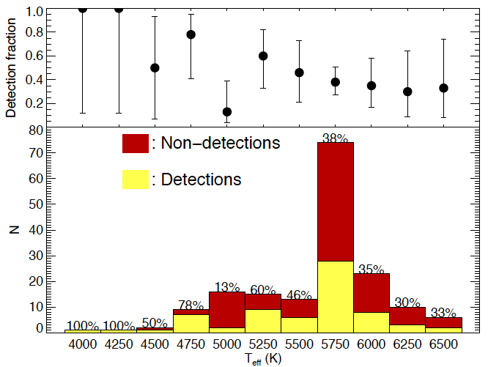
Bcool snapshot survey
Main sequence:
67 detections (~40%)
Subgiants :
2 detections (~10%)
More detections
in K dwarfs (?)
See also Matthew’s talk!
Marsden+ 2014

Slide 7
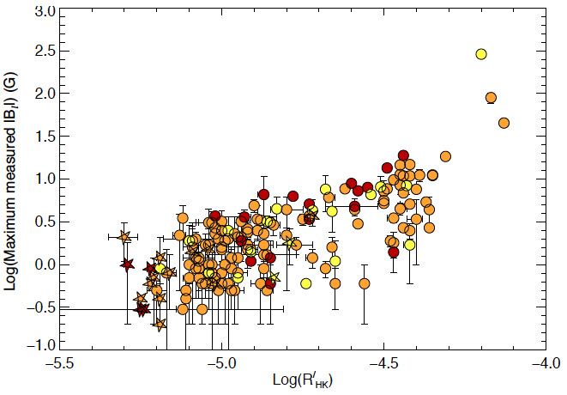
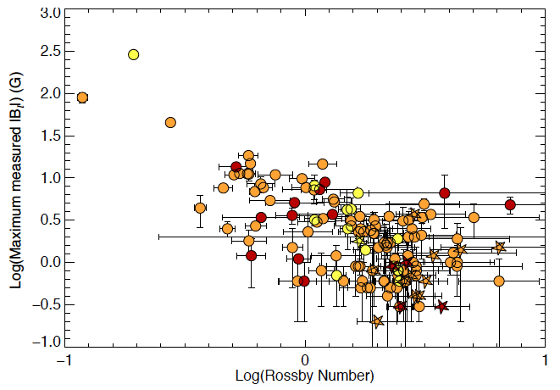
B versus activity & rotation
Correlation with
chromospheric emission (R’_{hk})
Anti-correlation with
Rossby number
(Ro = P_{rot} / τ_{conv})
Marsden+ 2014

Slide 8
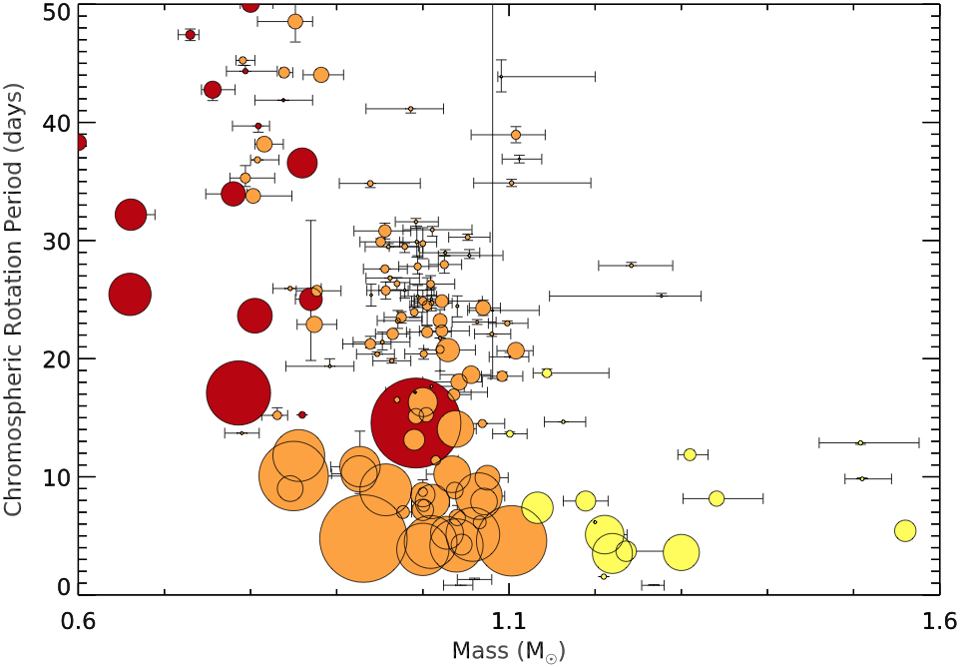
Bcool stars in the mass-rotation plane
(Symbol size prop to B)
Marsden+ 2014

Slide 9
Open questions
What is the upper temperature boundary of B detection?
Where are Maunder minimum stars?
(should we expect outliers in the B - R’_{HK} plot?)
What about strong versus weak fields in radiative zones?

Slide 10
Zeeman-Doppler
Imaging
1 - Longitude of
magnetic regions

Slide 11
Zeeman-Doppler
Imaging
2 - Latitude of
magnetic regions

Slide 12
Zeeman-Doppler
Imaging
2 - Latitude of
magnetic regions

Slide 13
Zeeman-Doppler
Imaging
3 - Orientation of
field lines

Slide 14
Time-series
of polarized profiles
Inversion code
Reconstructed geometry

Slide 15
Rotation &
Spatial resolution
Lower v.sin(i)
(projected rotational velocity):
Lower spatial resolution
HR 1099: v_{eq} = 40 km/s
Sun: v_{eq} ~ 2 km/s

Slide 16
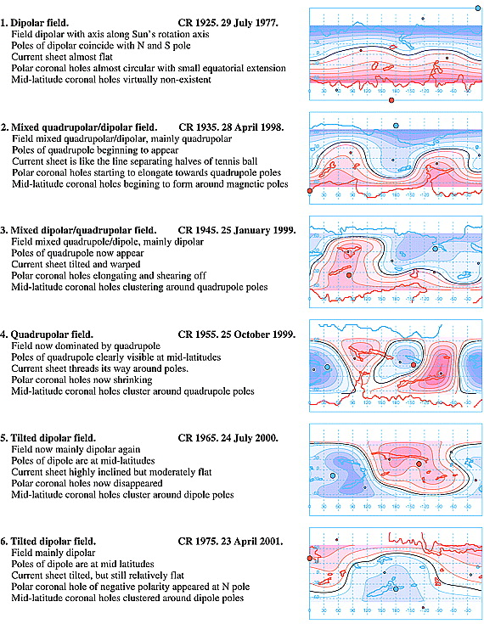
ZDI of the sun « as a star »:
Global solar field
~ Dipolar at activity minimum
More complex near maximum
(quadrupole ou octupole)
< 10 Gauss
(versus > 1 kG in spots)
Sanderson+ (2003)

Slide 17
Rotation &
Spatial resolution
Lower v.sin(i)
(projected rotational velocity):
Lower spatial resolution
increased sensitivity
HR 1099: v_{eq} = 40 km/s
Sun: v_{eq} ~ 2 km/s

Slide 18
ZDI of the Sun « as a star »
HMI magnetogram
Velocity map
Continuum map
« sun-as-a-star » (disc-inegrated)
Stokes I & V line profiles
ZDI solar map
Filtered HMI magnetogram
(2012 Sept.)
Fares+ (in prep.)

Slide 19
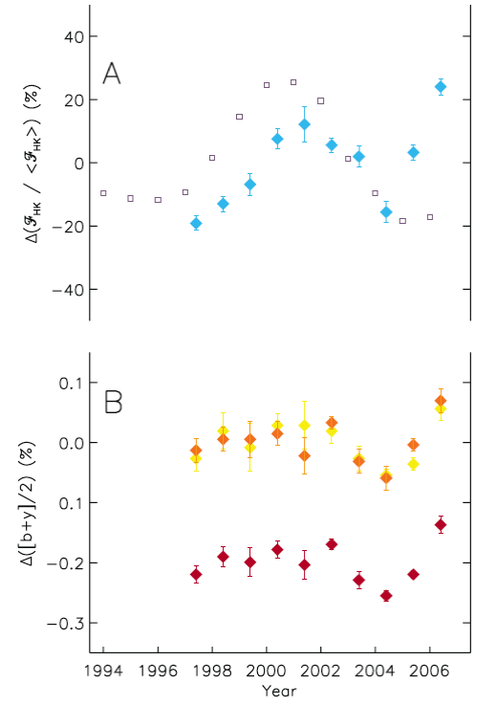
CaII H & K core emission
ZDI of a solar twin
18 Scorpii :
best naked-eye solar twin
(except Li overabundance)
T_{eff} = 5791 ± 50 K
[M/H] = 0.03 ± 0.03
log(g) = 4.41 ± 0.06
P_{rot} ~ 23 d (Petit+ 2008)
M = 1 ± 0.01 M_{sun}
(Bazot+ 2011)
Activity cycle ~ 7 ans
Photometry
(Hall+ 2007)

Slide 20
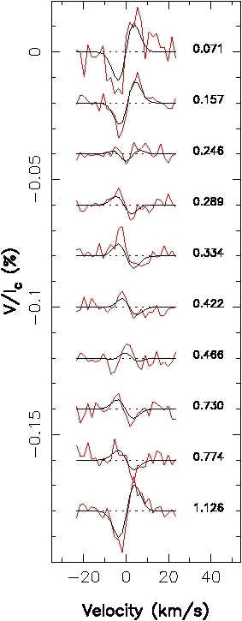
ZDI of a solar twin
18 Scorpii
NARVAL observations, 2007
(at activity maximum)
Detection of rotationally-modulated
Zeeman signatures
(Petit+ 2008)

Slide 21
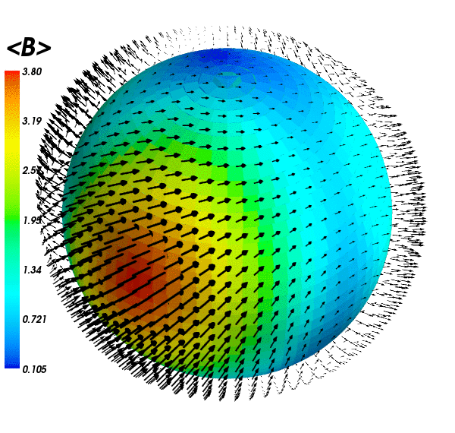
ZDI of a solar twin
Mean field : 3 ± 1 G
B² distribution:
34% dipole
56% quadrupole
10% octupole
Large-scale magnetic geometry
consistent with solar maximum
Credits C. Folsom, after Petit+ 2008

Slide 22
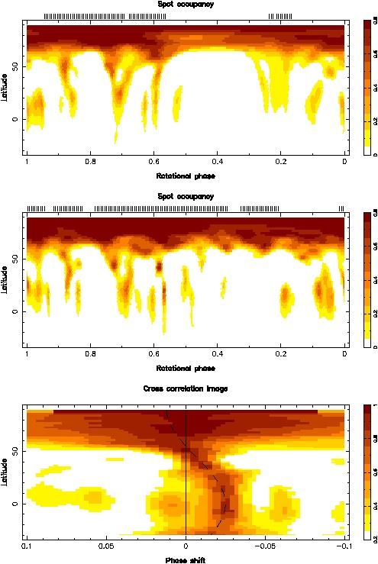
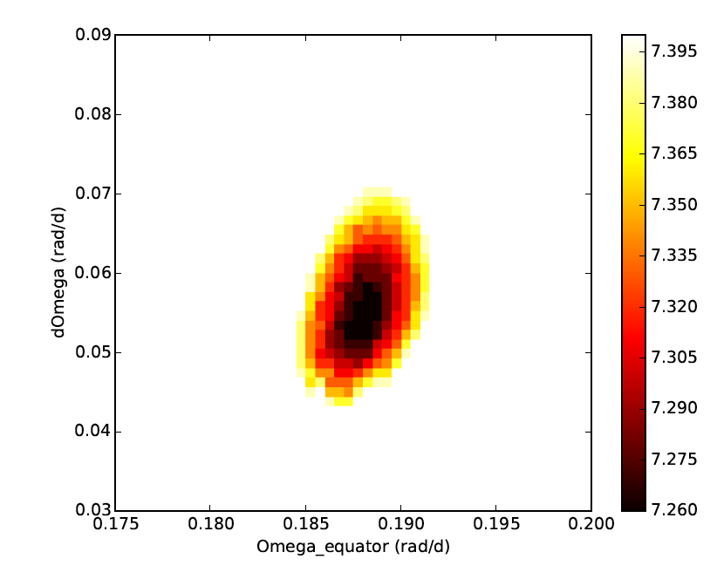
Surface differential rotation
61 Cyg A
AB Dor
ZDI model assuming:
Ω(l) = Ω_{eq} – ΔΩ.sin²(l)
Petit+ 2002,
Boro Saikia+ 2016 (submitted)
See also Sudeshna’s talk!
Cross-correlation method (donati & Collier Cameron 1997)

Slide 23
Zeeman-Doppler Imaging
Assets of Zeeman-Doppler Imaging for BCool:
Tested on solar data
Tested on solar twins
Able to estimate rotation & differential rotation
Models become more complex in case of:
Strong magnetic fields
Large brightness spots
Ideally, ZDI should include all 4 Stokes parameters
See also Oleg’s talk!

Slide 24
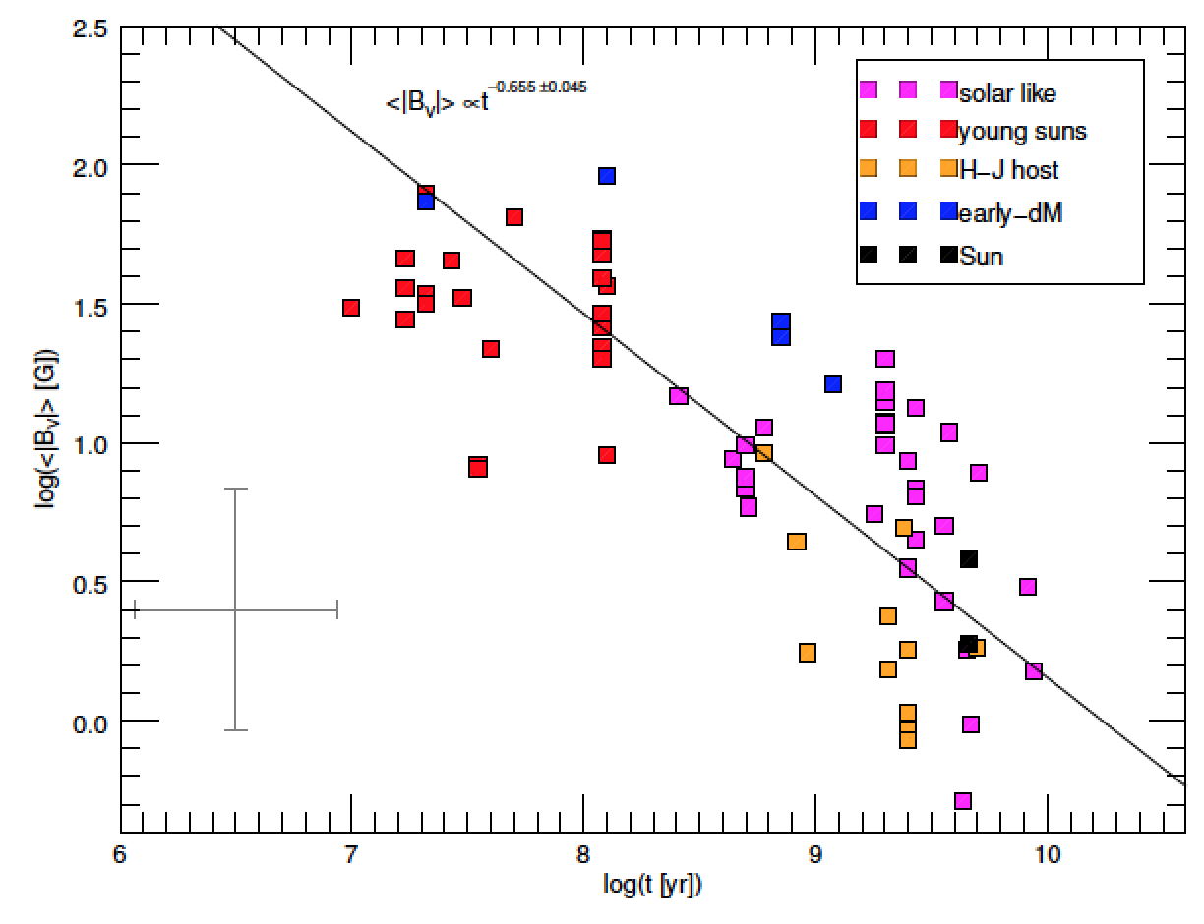
Empirical trend with stellar age
Vidotto+ 2014
See also Colin Folsom’s talk!

Slide 25
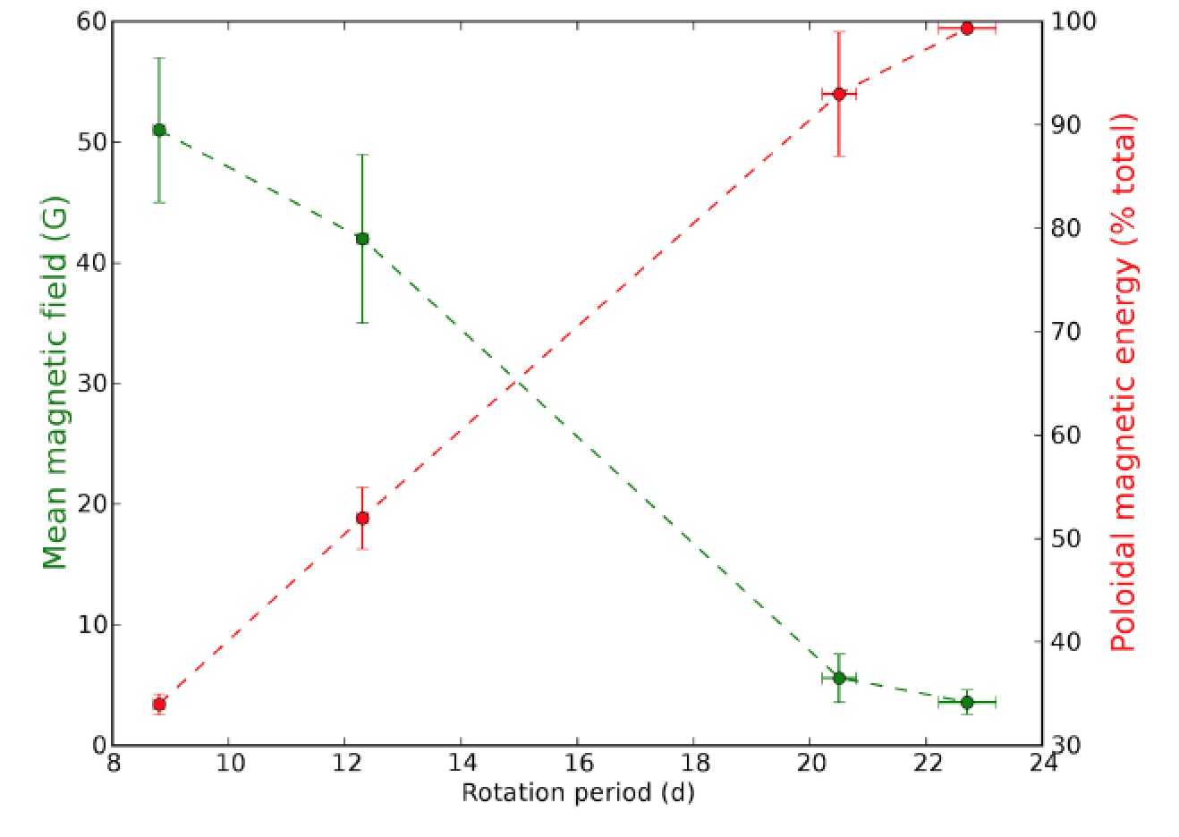
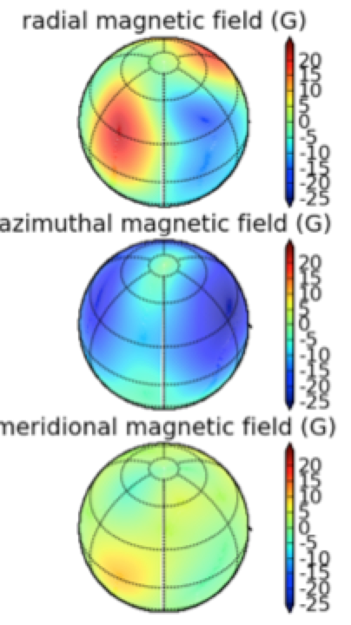
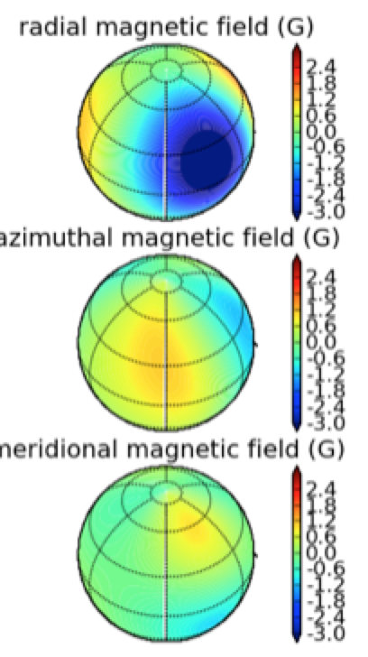
Surface toroidal component
Petit+ 2008

Slide 26
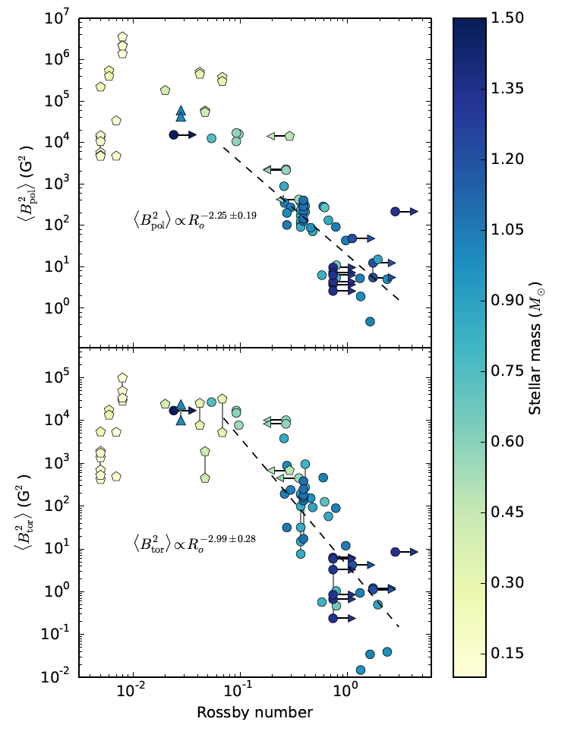
Surface toroidal component
Toroidal component grows
faster than poloidal one
See+ 2015

Slide 27
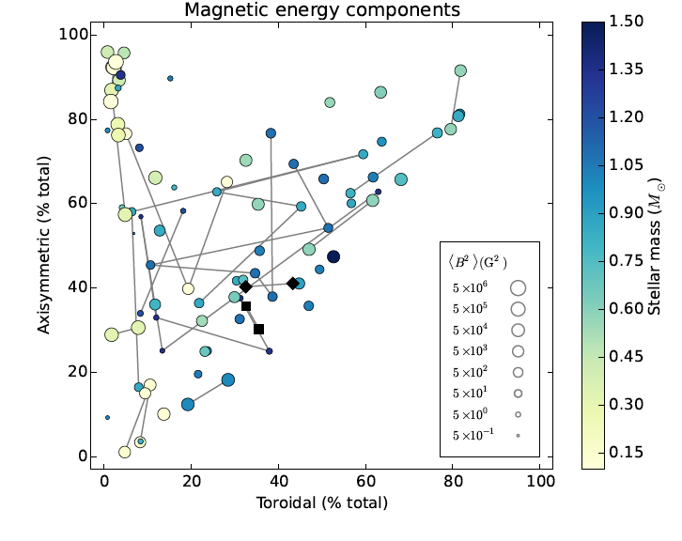
Surface toroidal component
Toroidal component grows
faster than poloidal one
More axisymmetric field in stars with
strong toroidal field
See+ 2015

Slide 28
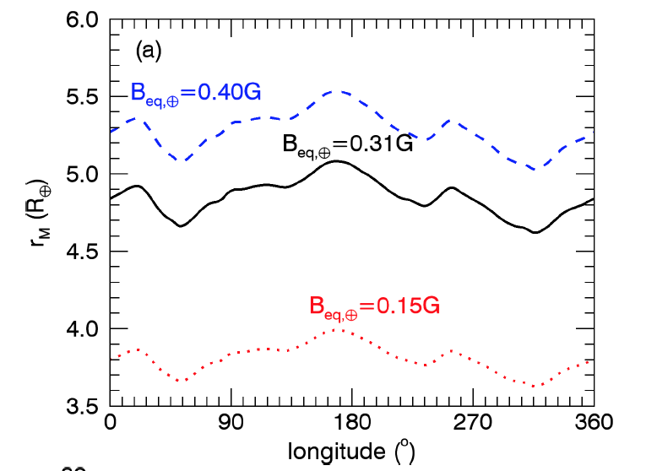
Stellar winds
Use surface maps to build
stellar wind models
kappa Ceti, Do Nascimento+ (submitted)
See also Aline’s talk!

Slide 30
Impact of brightness inhomogeneities
Ignoring Stokes I in the model:
Model with Stokes I & V:
Rosen & Kochkhov (2013)

Slide 31
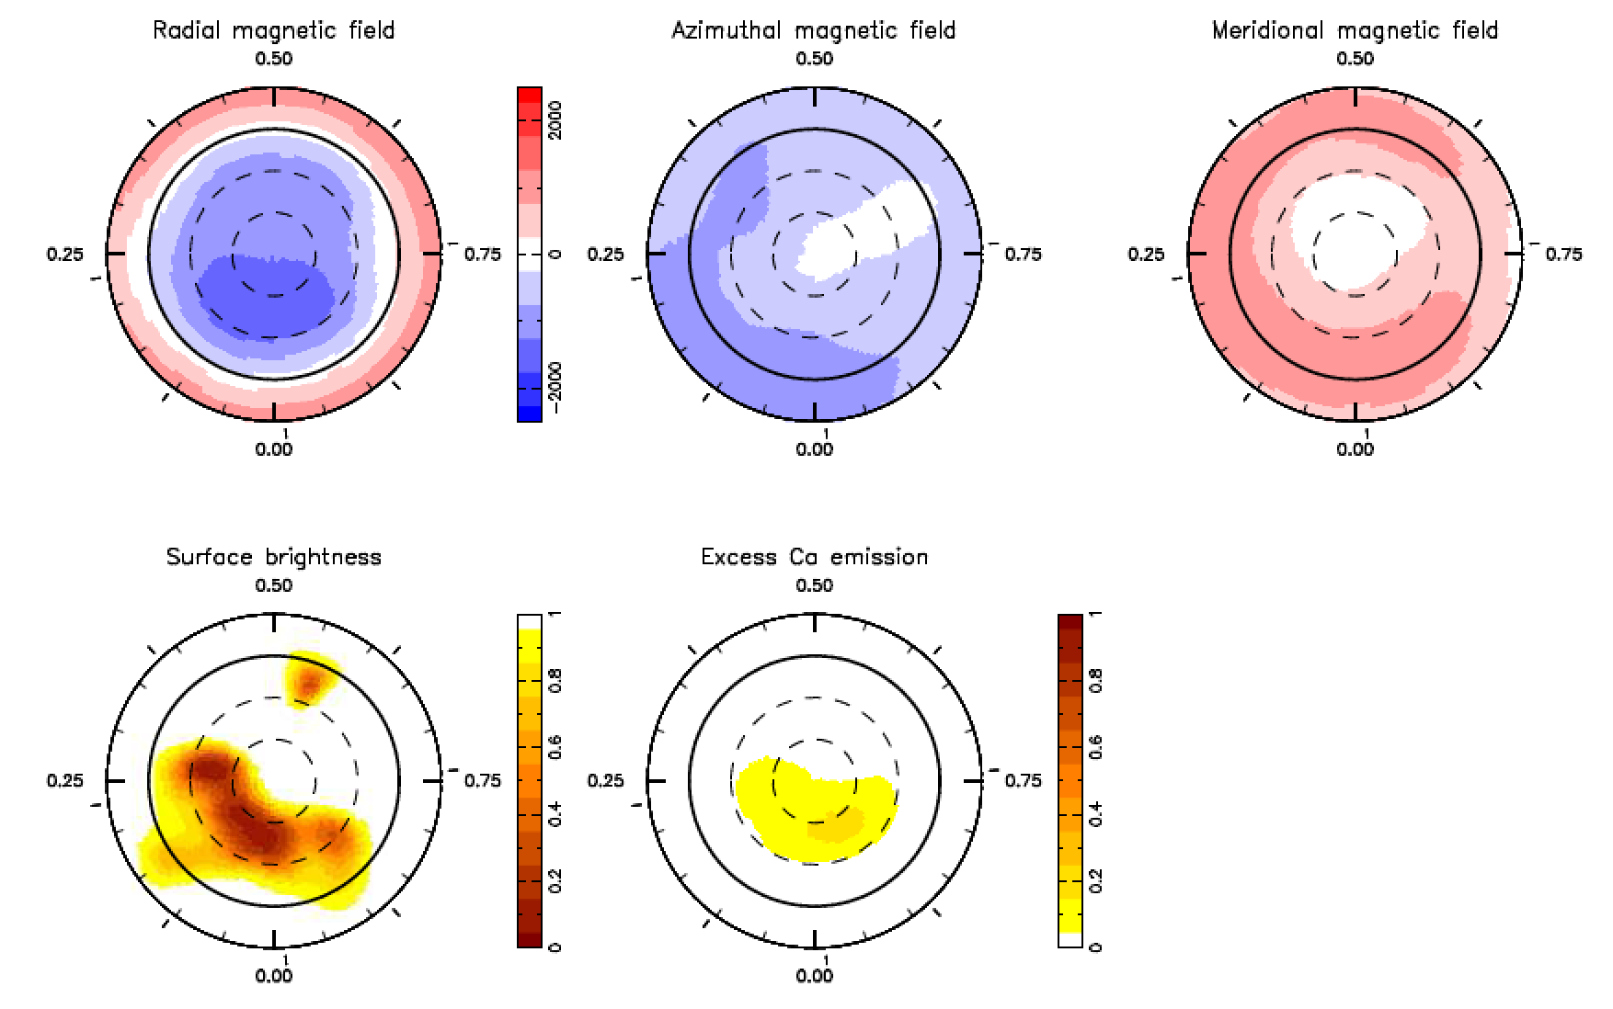
Magnetospheric accretion
Large dark spots
no weak-field regime
spectral imprint of accretion in emission lines (Stokes I & V)
AA Tau (Donati+ 2010)
see also Donati+ 2013

Slide 32
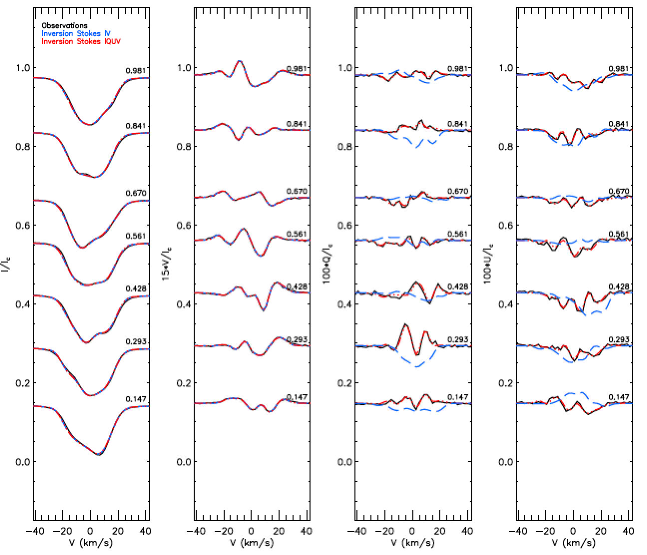
ZDI using all Stokes parameters
II Peg, Rosen+ 2014. See also Lisa’s poster!

Slide 33
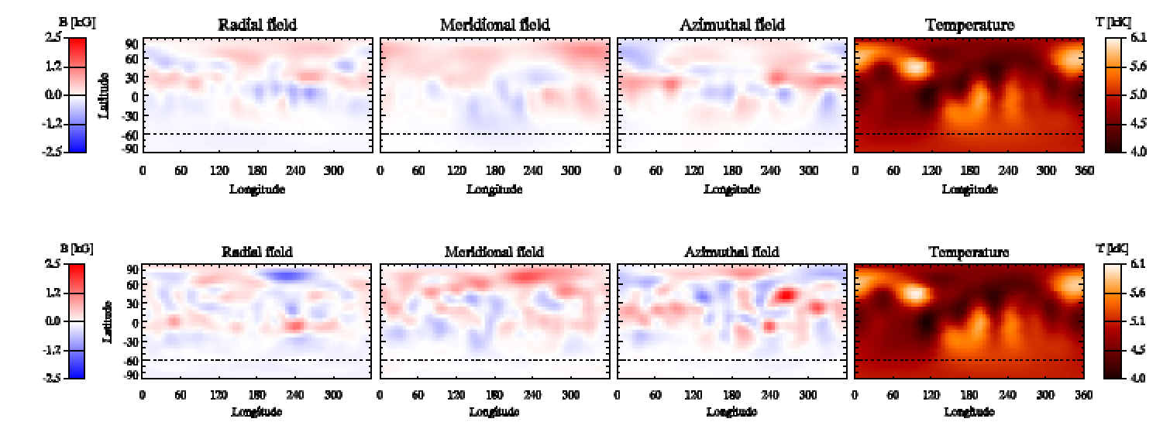
ZDI using all Stokes parameters
ZDI model with Stokes I+V:
ZDI model with Stokes I+V+Q+U:
II Peg, Rosen+ 2014. See also Lisa’s poster!

Slide 34
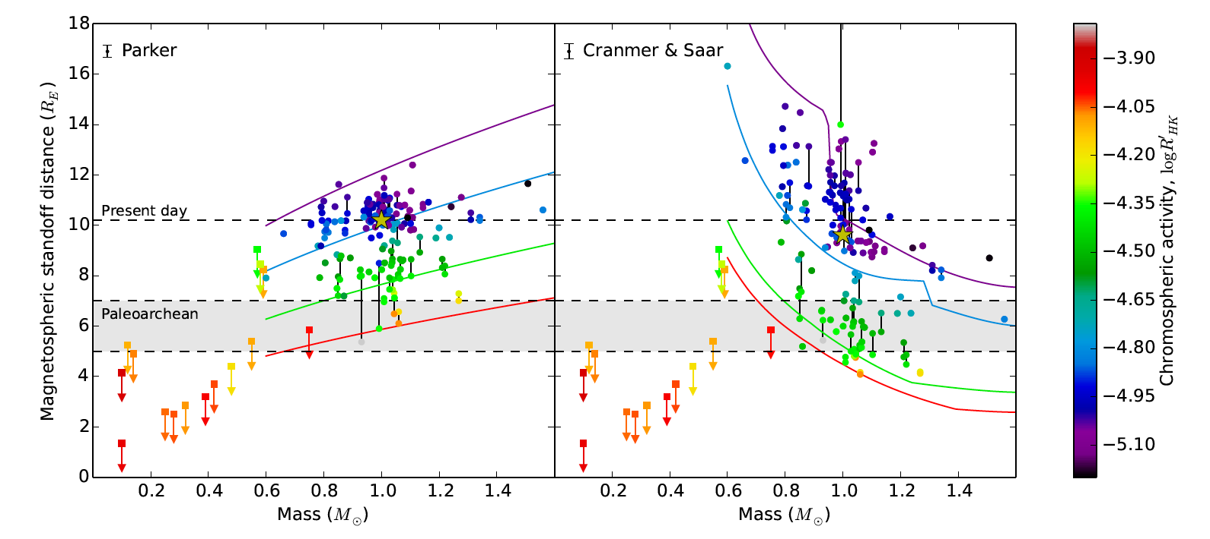
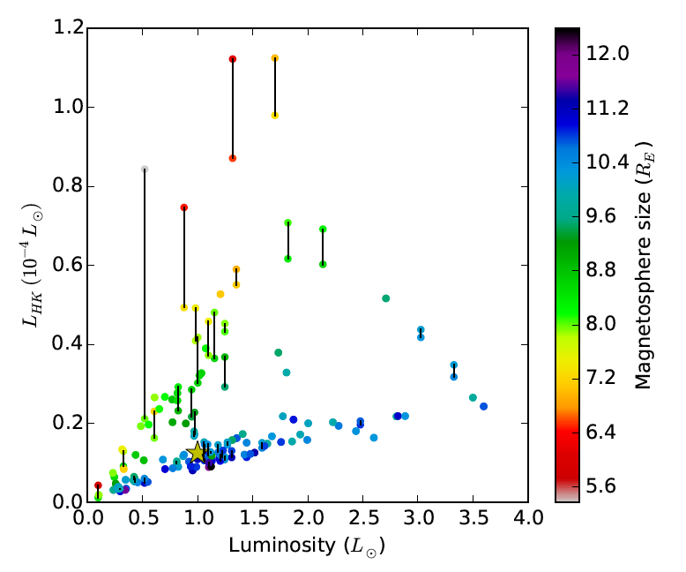

Slide 35
