Slide 1


Magnetic Fluxes in M dwarfs
BCool 2016
Vienna
Freiburg, Germany
Using molecular lines in multi-line methods
Nicolas Fabas
Svetlana Berdyugina
16-02-2016

Slide 2
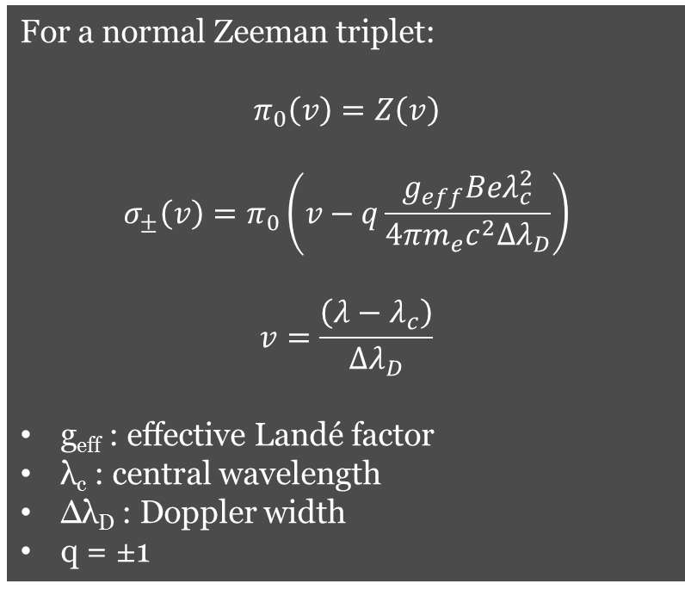
ZCD
Zeeman Component Decomposition
Sennhauser et al. 2010,2011
Not one single line profile but several for each Zeeman component
Non-linearity in blends
Milne-Eddington model
For a normal Zeeman triplet:
$$π_{0}\left(v\right)=Z\left(v\right)$$
$$σ_{±}\left(v\right)=π_{0}\left(v−q\frac{g_{eff}Beλ_{c}^{2}}{4πm_{e}c^{2}Δλ_{D}}\right)$$
$$v=\frac{\left(λ−λ_{c}\right)}{Δλ_{D}}$$
g_{eff} : effective Landé factor
λ_{c} : central wavelength
Δλ_{D} : Doppler width
q = ±1

Slide 3
ZCD
Zeeman Component Decomposition
Knowing the following parameters:
common line profile Z
line depth d_{c}
amplitude and orientation of a magnetic field defined by B, γ and χ
, one can combine them to obtain all the Stokes parameters using polarized radiative transfer (Unno 1956, Rachkovsky 1962)
We employed the polarized radiative transfer code STOPRO (Solanki 1987, Frutiger et al. 2000, Berdyugina et al. 2003)
Access to the magnetic flux
B.cos(γ).ff
with Stokes V

Slide 4
ZCD
Zeeman Component Decomposition
Sennhauser & Berdyugina 2011
→ Detection of a weak magnetic field on Arcturus using ZCD (atomic line mask)

Slide 5
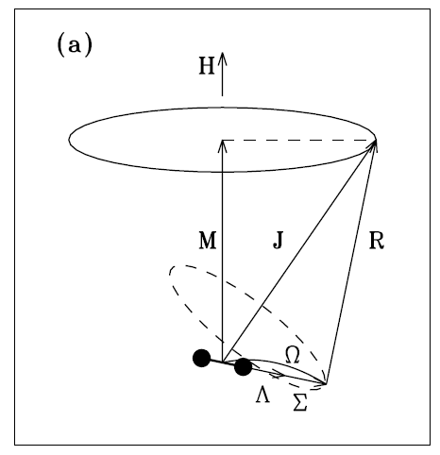
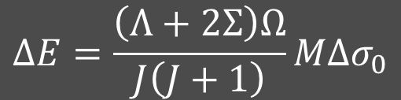

Molecular lines
We focus on the TiO γ(0,0)R₃ (Berdyugina et al. 2003, Afram et al. 2015)
Lines forming in spots and ubiquitous in M dwarves
Hund’s case a : strong coupling of orbital (L) and spin (S) with the internuclear axis of the molecule.
$$ΔE=\frac{\left(Λ+2Σ\right)Ω}{J\left(J+1\right)}MΔσ_{0}$$
Λ=0,1,2,…,L
Σ=S,S-1,…,-S
Ω=|Λ+Σ|
J= Ω ,Ω+1, Ω+2,…
$$Δσ_{0}=μ_{0}H$$
Berdyugina & Solanki 2002

Slide 6
Molecular lines
Modelling and detection of the molecular Zeeman effect in cool active stars
EV Lac
Model
Combination of photosphere and spot:
T_{phot}=3500K, T_{spot}=3000K
Filling factor 10 %
Solid line: B_{spot}=1kG
Dashed line: B_{spot}=3kG
Afram & Berdyugina 2015
Sunspot
Berdyugina et al. 2006

Slide 7
ZCD with TiO lines
Morin et al. 2008
EV Lac: M3.5, v.sin(i)=4.0 km.s⁻¹
AD Leo: M3, v.sin(i)=3.0 km.s⁻¹
Narval observations from 2007 to 2008

Slide 8
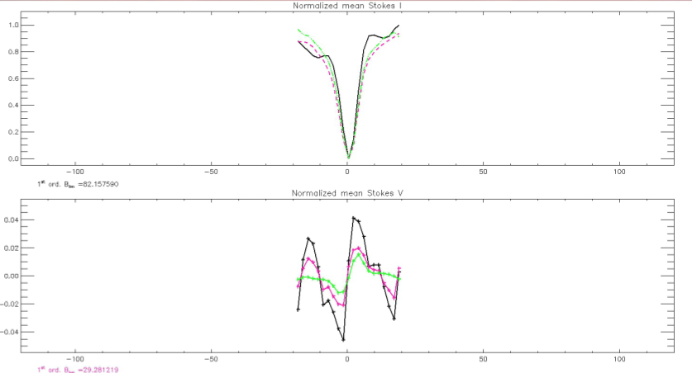
ZCD with TiO lines
Result with 450 lines
Common profile
EV Lac
Narval
02/08/2007
LSD
NDD
ZCD

Slide 9
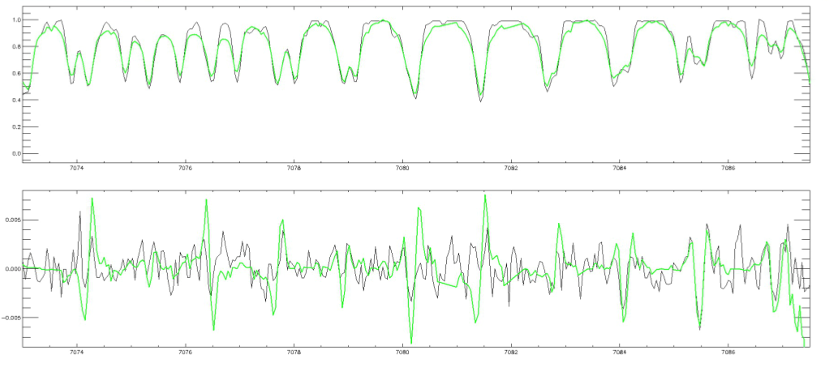
ZCD with TiO lines
Result with 450 lines
Spectra
EV Lac
Narval
02/08/2007
Observed
ZCD fit
7074
7080
7086

Slide 10
ZCD with TiO lines
Time evolution of the magnetic flux
EV Lac (Morin et al. 2008)
Mask of atomic lines, LSD method

Slide 11
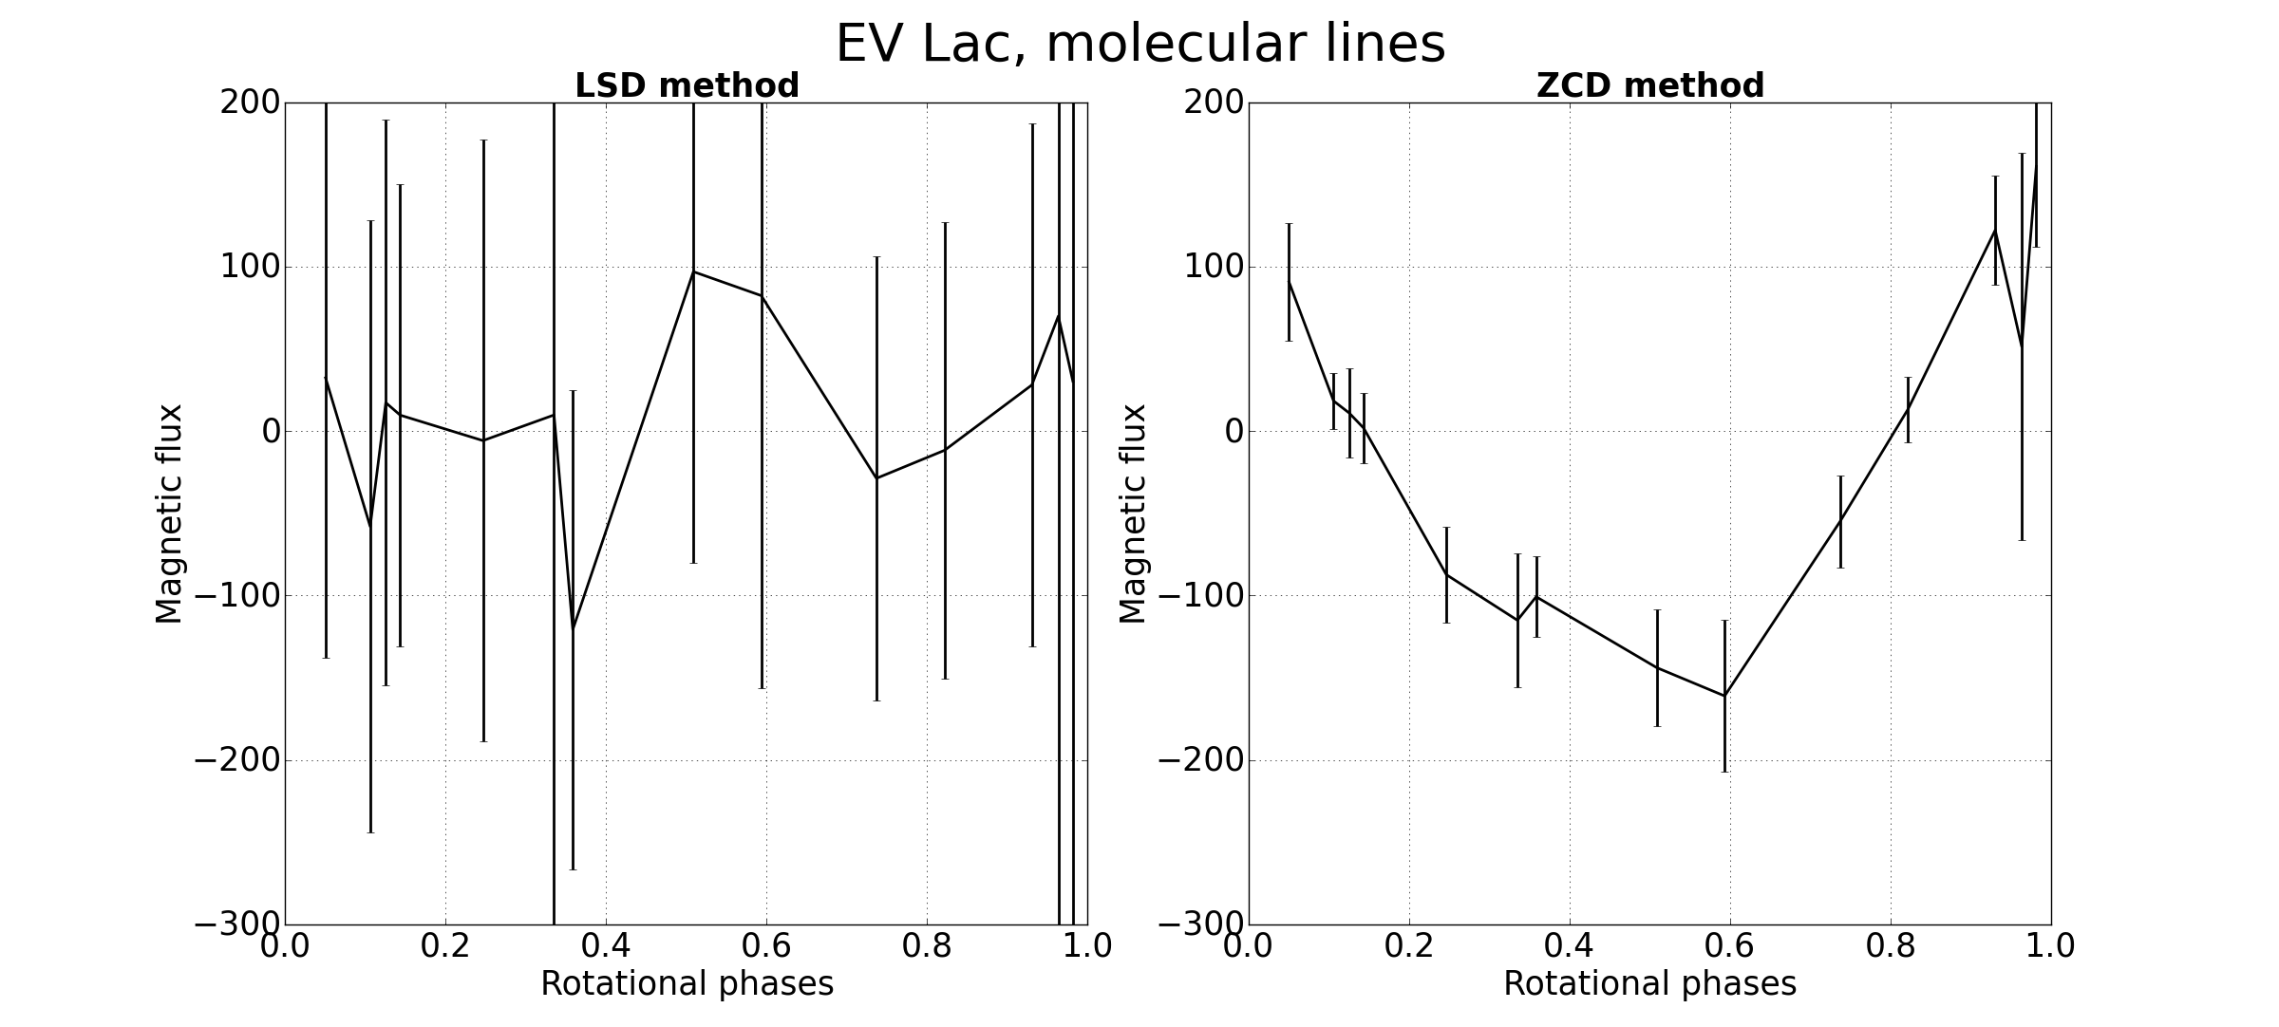
ZCD with TiO lines
Time evolution of the magnetic flux

Slide 12
ZCD with TiO lines
Time evolution of the magnetic flux
AD Leo (Morin et al. 2008)
Mask of atomic lines, LSD method

Slide 13
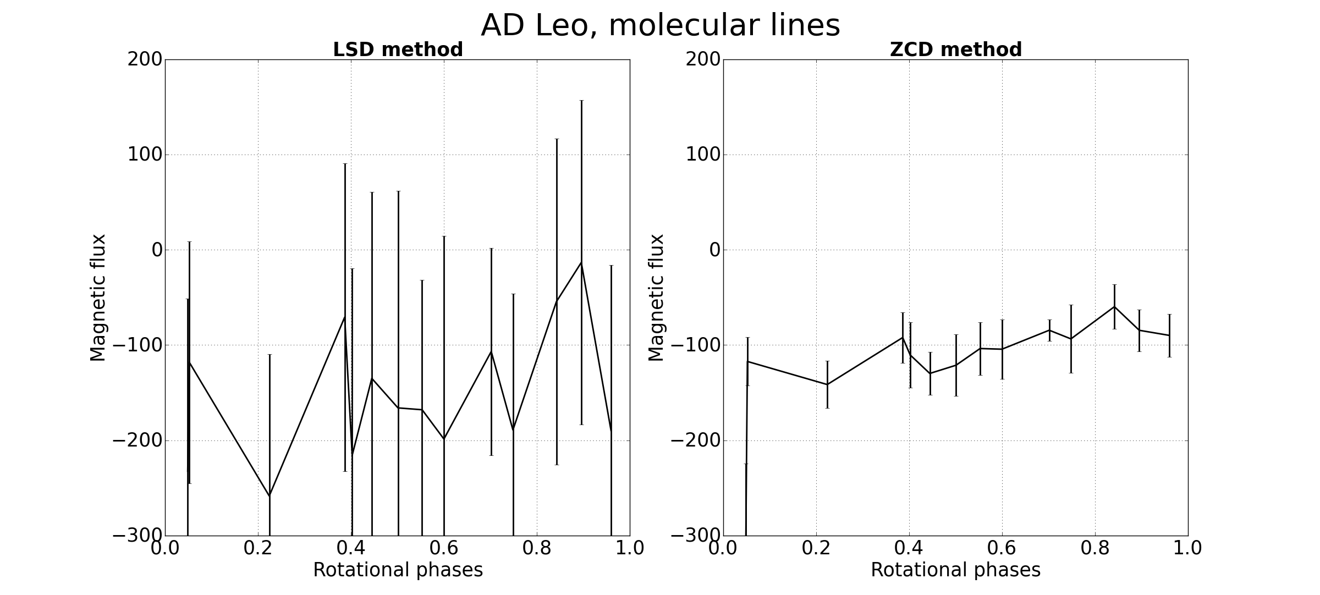
ZCD with TiO lines
Time evolution of the magnetic flux

Slide 14
TiO band fitting
Accessing to magnetic field and filling factor
B.cos(γ).ff → B.cos(γ) and ff
We combine two models:
Photospheric: T_{phot}=3000K, B_{phot}=0G
Spot: T_{spot}, B_{spot}
Model
Combination of photosphere and spot:
T_{phot}=3500K, T_{spot}=3000K
Filling factor 10 %
Solid line: B_{spot}=1kG
Dashed line: B_{spot}=3kG
Afram & Berdyugina 2015
We fit the output model to the Narval or Espadons observations
Grid used:
T_{spot}: 2500, 2600, 2800 K
B_{spot}: 50, 100, 200, 500, 1000 G
γ: 0, 30, 60, 90, 120, 150 deg.
ff : 0.1, 0.2,…,1.0
v.sin(i): 0.0, 2.0,…, 14.0 km/s

Slide 15
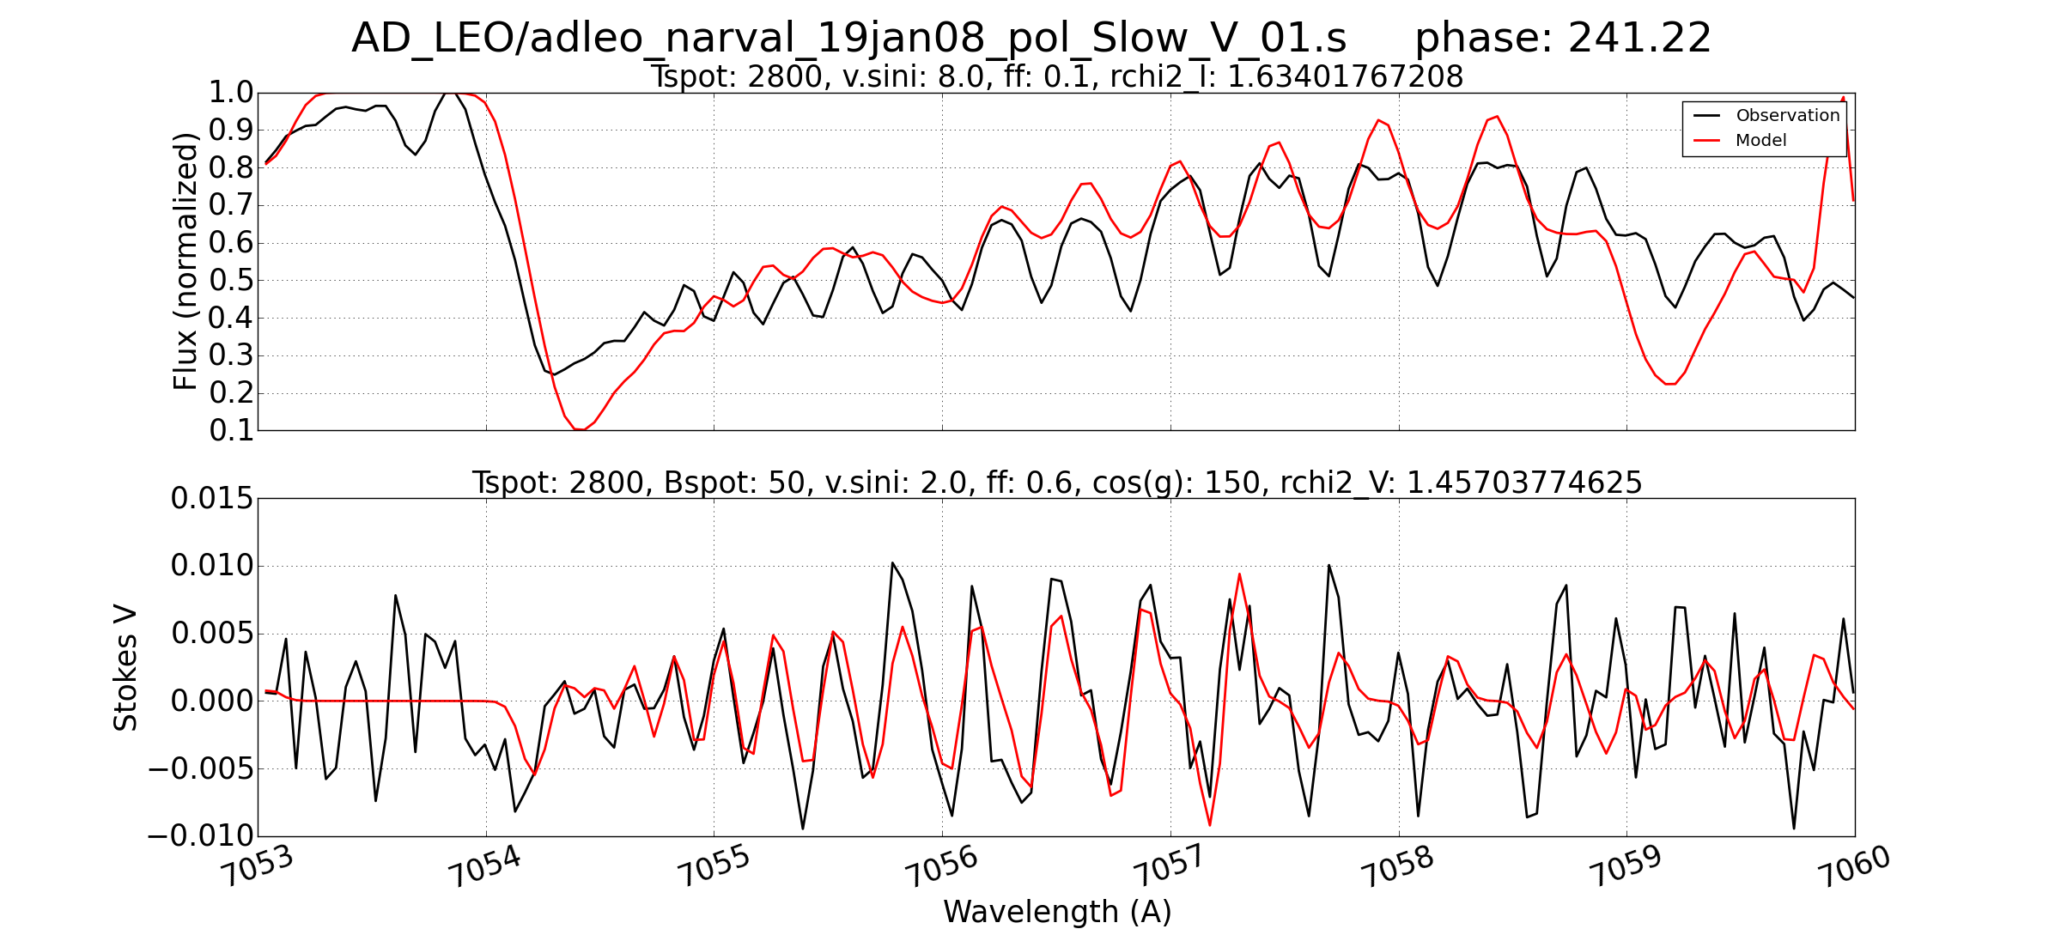
TiO band fitting

Slide 16
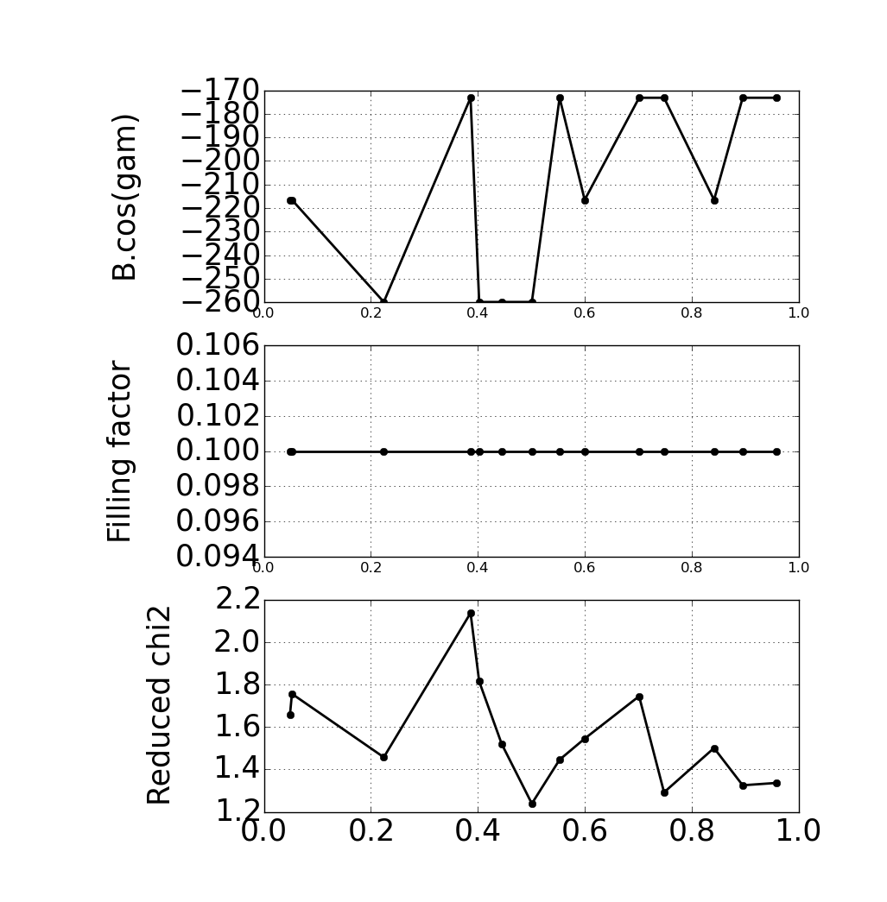

AD Leo
Morin et al. 2008

Slide 17
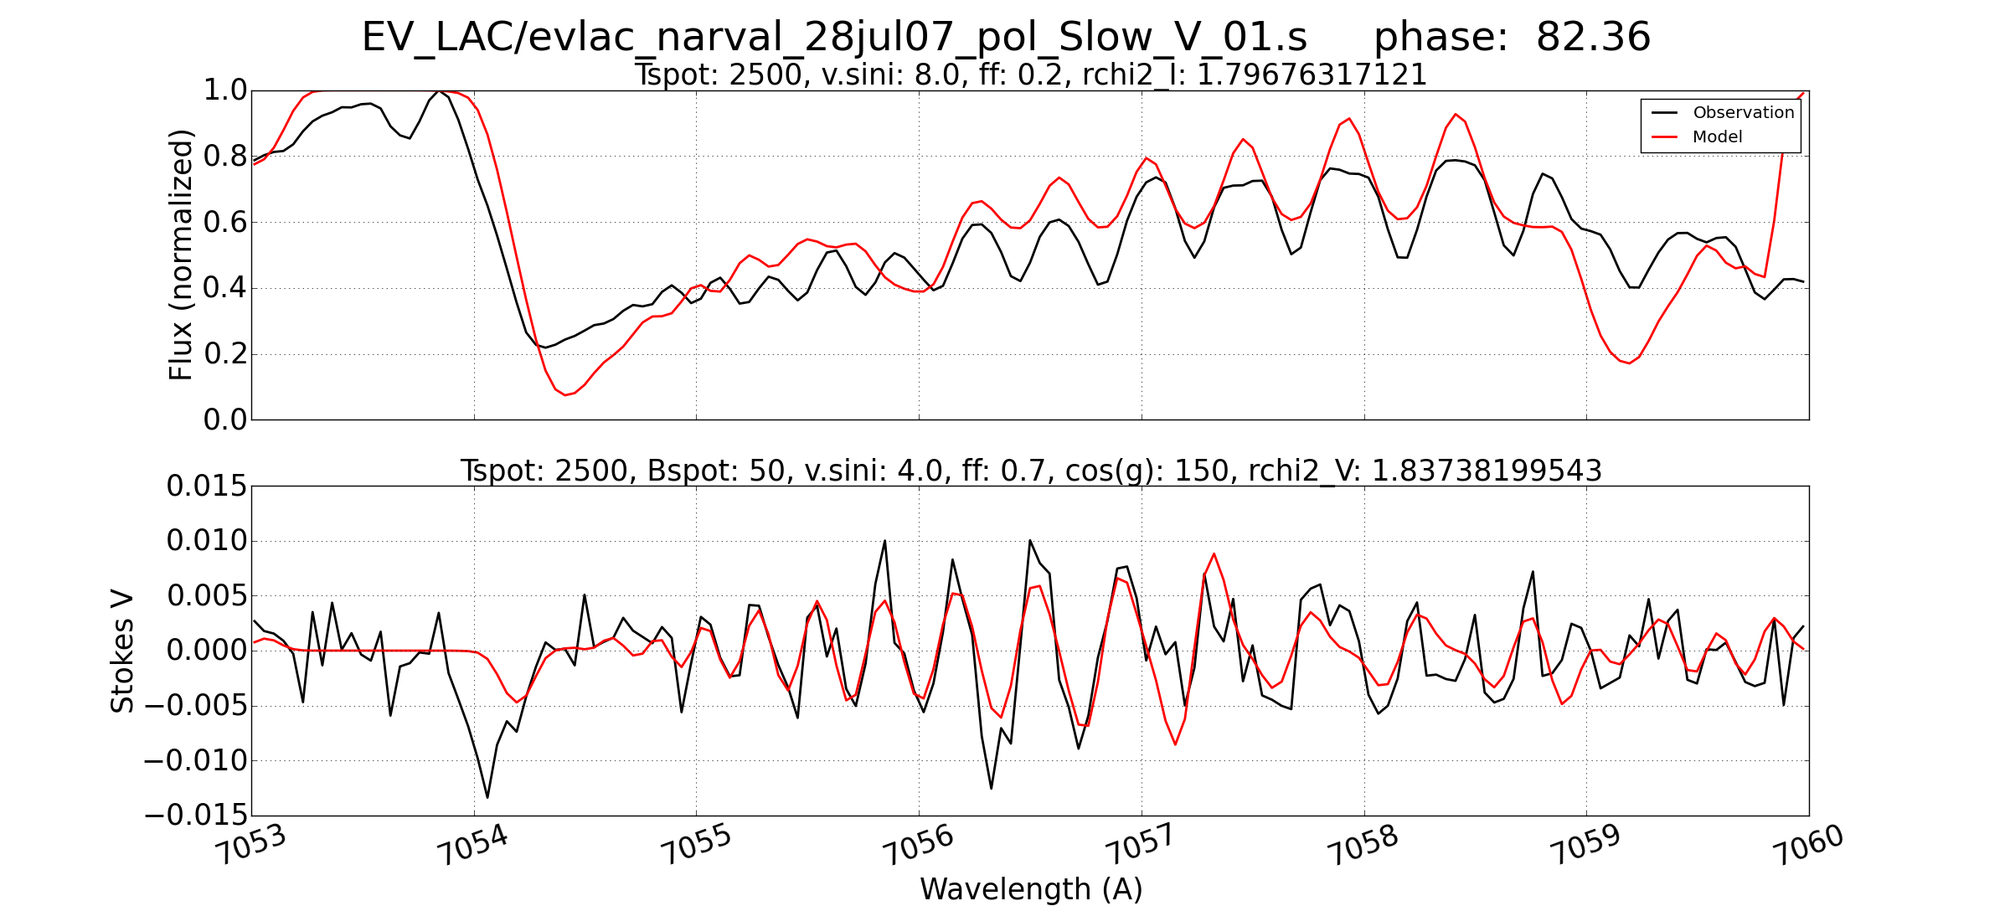
TiO band fitting

Slide 18
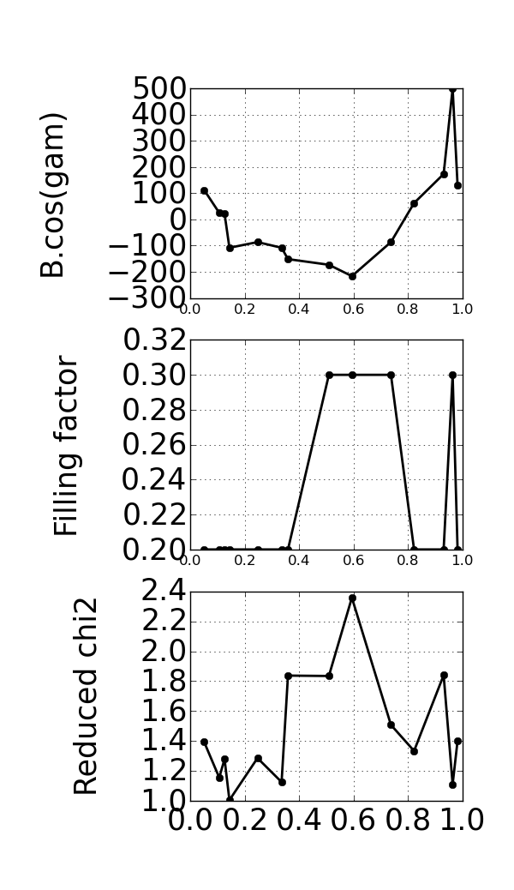

EV Lac
Morin et al. 2008

Slide 19
Band fitting in Brown Dwarfs
From Oleksii Kuzmychov
Full Stokes and low resolution spectropolarimetry (R=300 to 5000)

Slide 20
Conclusions
ZCD is a clear improvement on LSD when it comes to molecular lines
Molecular band fits allow to separate magnetic field from filling factor
In both cases, the evolution of magnetic fluxes and fields are consistent with previous observations in Morin et al. 2008, in the case of EV Lac and AD Leo
No need for high resolution spectropolarimetry when considering molecules
ZCD could find applications for many cool objects, e.g. active dwarfs, AGB stars, sunspots…

